Slide 1
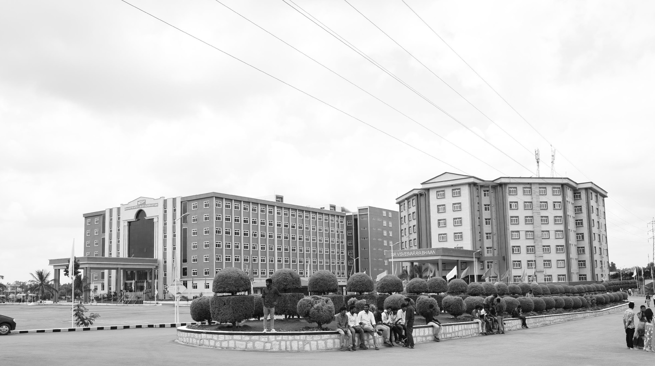

Image Based Bird Species Identification
AY 2020-24
GITAM UNIVERSITY
Major Project
Project ID: A7
A University should be a place of light, of liberty, and of learning.
Department of Electrical Electronics and Communication Engineering
Project Team:
Kaniki Chakradhar Reddy
Bulla Yagnesh Reddy
Project Mentor:
Dr. Venkata Kranti
www.gitamedu.com

Slide 2



Project Group – Details
Photo
Track
Roll No
Name
Photo
EECE AI/ML
BU21EECE0100170
Kaniki Chakradhar Reddy
Photo
EECE AI/ML
BU21EECE0100198
Bulla Yagnesh Reddy

Slide 3
Abstract
Bird species identification using images is vital for ecology studies and conservation. Birds, as both predators and prey, play crucial roles in ecosystems. Despite their importance, many species are endangered and difficult to classify due to varying sizes, shapes, and colours. Traditional identification methods are labour-intensive and costly. Automated systems using deep learning and convolutional neural networks (CNNs) offer a solution by analysing visual data to accurately identify bird species. This approach supports researchers and conservationists by providing efficient tools for monitoring and preserving avian biodiversity. Numerous studies have demonstrated the effectiveness of these techniques using diverse datasets and machine learning models.

Slide 4
Objective and Goals
Objective
Automate Bird Species Identification: Develop a deep learning-based system using CNNs to identify bird species from images efficiently.
Support Conservation and Research: Provide tools to researchers and conservationists for monitoring bird populations, reducing the need for traditional, labor-intensive methods.
Focus on Endangered Species: Prioritize identification of endangered or difficult-to-classify species to aid in their monitoring and protection.
Validate Model Accuracy: Ensure high accuracy and reliability of the model through testing on diverse datasets.
Goals
Achieve High Identification Accuracy: Aim for at least 95% accuracy in bird species classification by optimizing the deep learning model.
Develop a User-Friendly Platform: Create a web-based interface using Flask, HTML, CSS, and JavaScript for easy image upload and species identification.
Build a Diverse Image Dataset and Ensure Database Integration: Compile a comprehensive dataset of bird images across various conditions and design the system for compatibility with ecological databases.
Contribute to Conservation Efforts: Share project outcomes through publications and presentations to enhance global ecological and conservation initiatives.

Slide 5
Project Plan
Tasks | Start date | Days to complete | Milestones | Tasks to be completed
Task 1 | 19-Aug | 7 | project planning and requirement gathering | Define project scope and objectives. Research bird image classification techniques. Set up the development environment.
Task 2 | 26-Aug | 7 | Data preparation | Identify and compile a comprehensive bird image dataset. Preprocess the dataset (resize, normalize). Annotate or clean data as necessary. Split data into training, validation, and test sets.

Slide 6
Task 3 | 02-sep | 7 | Model selection and Development | Select the appropriate model architecture. Implement the image feature extraction module.
Task 4 | 09-Sep | 7 | Model selection and Development | Integrate the feature extractor with the classification module. Prepare the model for training.
Task 5 | 16-Sep | 7 | Model training | Train the model using the training dataset. Implement data augmentation techniques to improve model generalization.

Slide 7
Task 6 | 23-Sep | 7 | Model training | Validate the model using the validation dataset. Monitor and adjust for overfitting.
Task 7 | 01-Oct | 7 | Model Evaluation and Optimization | Evaluate the model on the test dataset. Fine-tune the model based on evaluation results. Optimize model performance for deployment.
Task 8 | 07-Oct | 7 | Deployment | Deploy the model in a real-time environment for end-users.
Task 9 | 14-Oct | 7 | Testing | Test the robustness of the model under different conditions.

Slide 8
Task 10 | 21-Oct | 7 | Documentation | Prepare the final report and presentation for project completion.

Slide 9
Literature Survey
SL.NO. | Title of the paper | Year | Author | Technology
1. | Visualization of audio records for automatic bird species identification | September 2015 | Angie K. Reyes Jorge E. Camargo | Audio Databases: Used Xeno-canto and BirdCLEF datasets for collecting Colombian bird audio records. Feature Extraction and Processing: Extracted Mel-Frequency Cepstral Coefficients (MFCC) using MATLAB. Distance Calculation: Employed the cosine distance function to assess similarity between audio records. Dimensionality Reduction and Visualization: Applied Principal Component Analysis (PCA) for dimensionality reduction and visualized results in a 2D space.
2. | Bird Species Recognition using Deep Learning | March 2023 | Hari Kishan Kondaveeti | Arduino UNO: A microcontroller board used to interface with sensors and control the image capture process. PIR Motion Sensor: Detects motion and triggers the ESP32 camera to capture images when a bird is detected. ESP32-Cam: A microcontroller with an integrated camera for capturing images and uploading them to Google Drive. Deep Learning (CNN): Utilizes Convolutional Neural Networks, specifically ResNet101V2, to analyze and classify bird species from the images.

Slide 10
3. | Automated Bird Detection using using Snapshot Ensemble of Deep Learning Models | January 2024 | Fazeelath Jahan Shaik Ganesan V | Deep Learning Models: For identifying bird species. Public Datasets: Images used for training and testing. Cameras: Capture bird images. Ensemble Learning: Combines multiple models for better accuracy.
4. | Bird Species detection using Python | January 2020 | Aniruddha Gayake | Python: Programming language used. Scikit Learn: Machine learning library. Machine Learning Algorithms: Naive Bayes SVM Decision Trees KNN LDA Random Forests Logistic Regression Feature Reduction: PCA and feature selection methods.

Slide 11
Analysis - SWOT
Strengths
Weaknesses
Data dependency
Computational requirements
Development costs
Limited real-time capability
High accuracy
Automation
User-friendly interface
Conservation focus
Threats
Opportunities
Rapid technological changes
Data privacy concerns
Environmental variability
Competition
Global conservation contribution
Scalability
Research collaboration
Citizen science integration

Slide 12
Analysis – 4W1H
What: Automated bird species identification system using deep learning, specifically Convolutional Neural Networks (CNNs).
Why: To improve efficiency in identifying bird species for ecological studies and conservation efforts, reducing reliance on labor-intensive and error-prone manual methods.
Who:
Primary Users: Researchers and conservationists who monitor bird populations and study avian biodiversity.
Secondary Users: Ecologists, ornithologists, and citizen scientists interested in bird conservation.
Where: The system will be deployed as a web-based platform, accessible to users globally through the internet.
How: By developing a deep learning model trained on a diverse dataset of bird images, integrated into a user-friendly web interface for easy image upload and species identification. The system utilizes advanced image processing techniques and neural networks to classify bird species accurately.

Slide 13
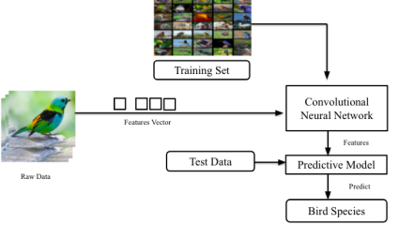
Architecture
Structural Diagram :
l

Slide 14
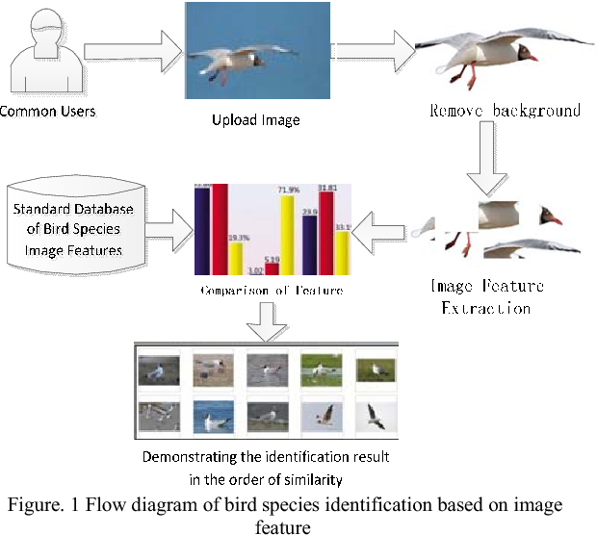
Behaviour diagram:

Slide 15
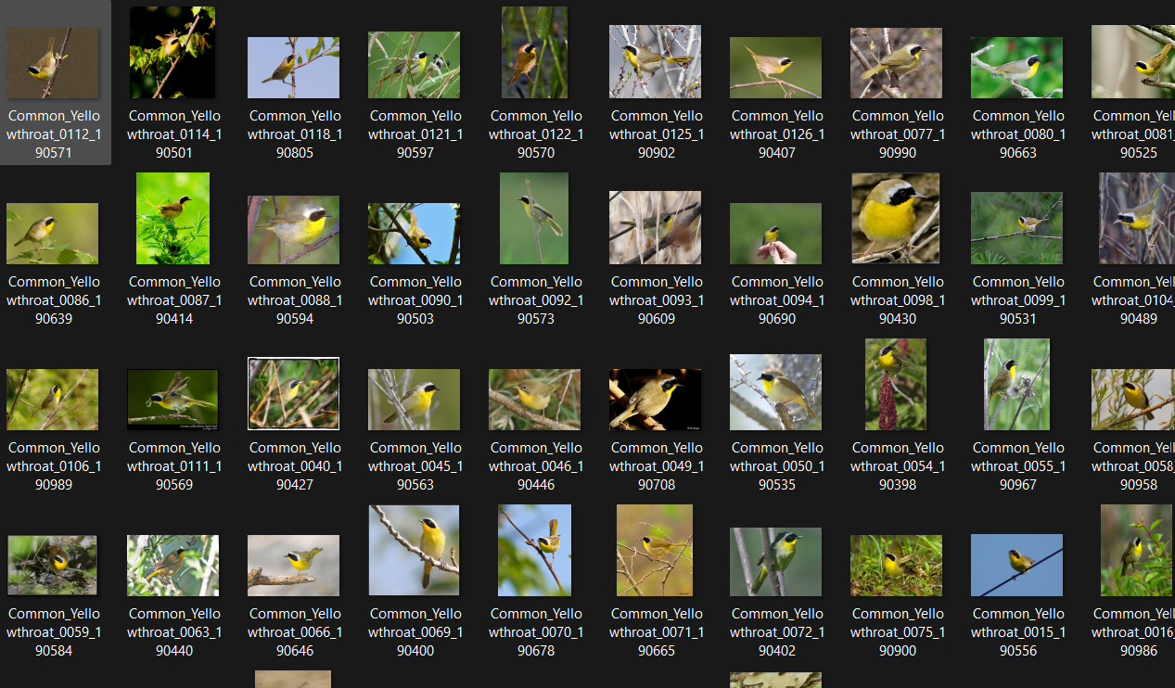
Collection of Dataset:

Slide 16
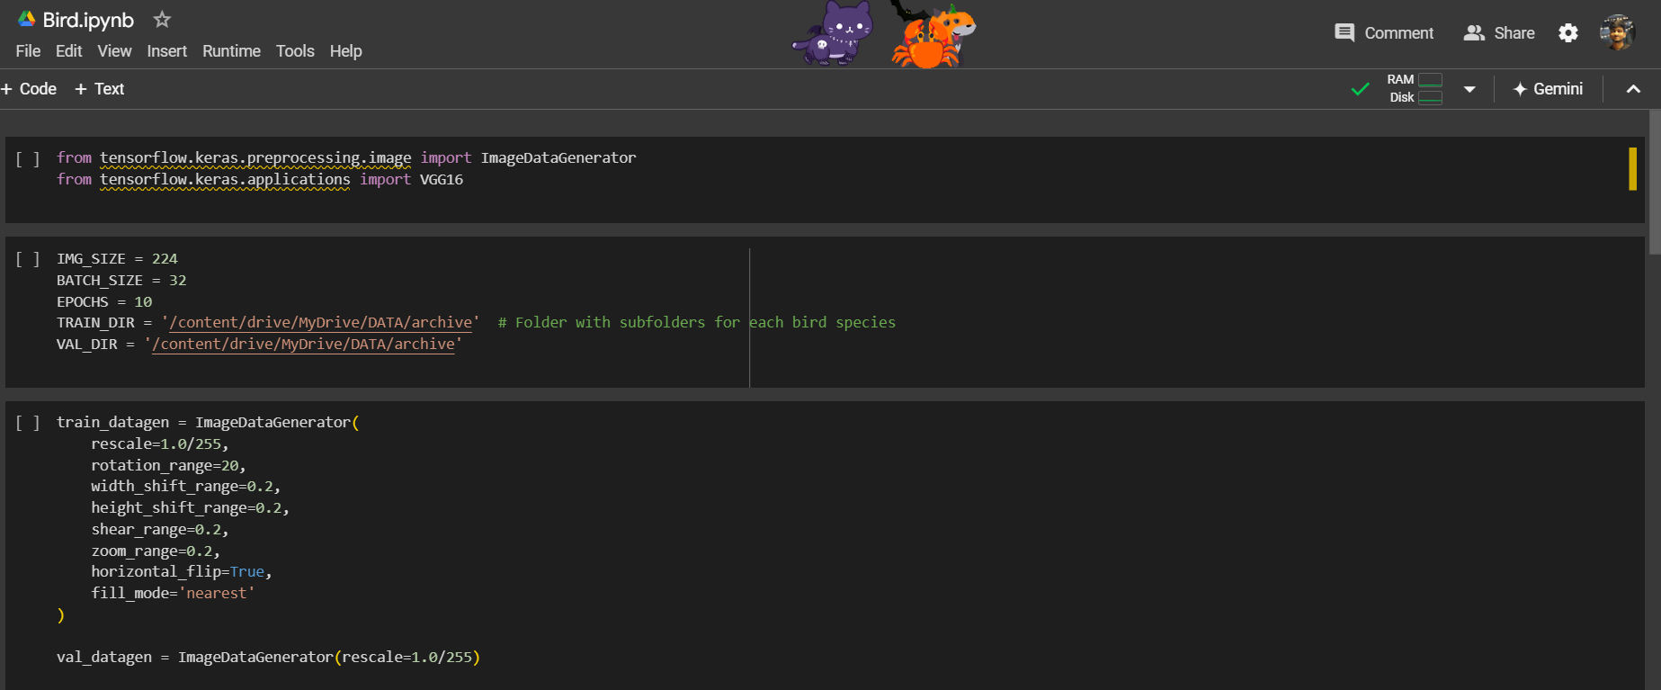

Slide 17
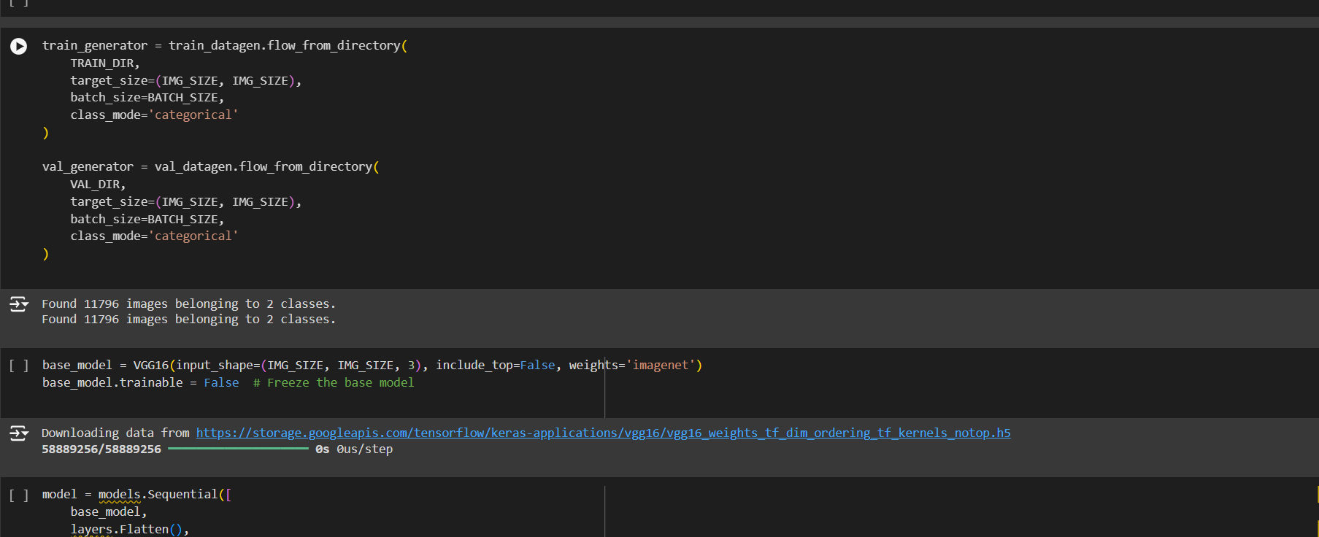

Slide 18
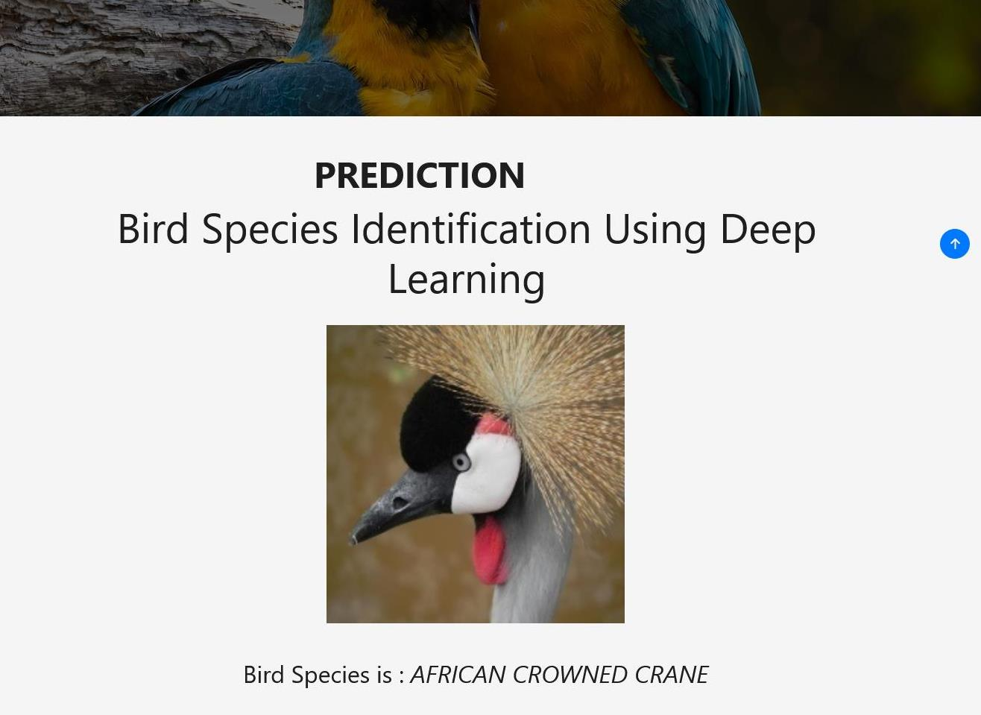
OUTPUT

Slide 19
Use Cases & Testing
Use Cases:
Data Augmentation for Training AI Models
Purpose: Generate synthetic bird images to augment training datasets for bird species identification models.
Educational Tools and Interactive Platforms
Purpose: Generate realistic images of bird species for educational apps or bird watching tools.
Conservation Awareness and Public Engagement
Purpose: Use generated bird images to raise awareness about threatened species and promote conservation efforts.
Art and Design Applications
Purpose: Generate realistic or stylized bird images for creative and artistic purposes.
Reconstruction of Extinct or Hypothetical Species
Purpose: Generate images of extinct bird species or hypothetical evolutionary outcomes.
Test cases:
Visual Accuracy Testing
Goal: Ensure that the generated bird images are visually accurate representations of real bird species.
Diversity and Variation Testing
Goal: Ensure that the generated images cover a wide variety of species, poses, and environmental conditions.
Generalization Testing
Goal: Ensure that the generated bird images can be effectively used for various applications like identification, conservation awareness, or creative design.
Consistency and Realism Testing
Goal: Ensure that generated images are consistent in terms of species-specific features and realistic enough for educational or scientific purposes.

Slide 20
Contribution
Team Progress and Movement
Dataset collected
Problem statement identified
Individual Contribution
Key contributions: Kaniki Chakradhar Reddy
PPT Design,Literature Survey
Working on different types of architecture and analysing the problems faced in it.
Key contributions: Bulla Yagnesh
Poster,DataSet Collection
Working on different types of architecture and analysing the problems faced in it.

Slide 21
Conclusion & Future Work
Summary and Conclusion
The main idea behind developing the identification website is to build awareness regarding bird watching, birds and identification. It also caters to the need of simplifying the bird identification process and thus making bird watching easier. The technology used in the experimental setup is Convolutional Neural Network (CNN). The result produced by our project, t has provided 80% accuracy for the prediction of bird species.
Future Work
Identification of different types of architecture available used in image identification .
Collection of Datasets.
Implementation of new idea (bird species identification using both image and voice using distance algorithm.
Execution of code .

Slide 22

THANK YOU

